Slide 1
Introduction of my research
Sitao Cheng
Websoft Lab (Advised by Yuzhong Qu)
Computer Science, Nanjing University

Slide 2
Contents
Backgrounds
LMs reasoning over structured environments
Publications
Call me when necessary: LLMs can Efficiently and Faithfully Reason over Structured Environments
QueryAgent: A Reliable and Efficient Reasoning Framework with Environmental Feedback based Self-Correction
MarkQA: A large scale KBQA dataset with numerical reasoning
Question Decomposition Tree for Answering Complex Questions over Knowledge Bases

Slide 3
Background
LMs reasoning over structured environments
Reasoning: Multi-hop reasoning task – Question answering
Structured Environments: Knowledge base, Table, Database
Where did daughters of Obama go to college?
father_of
Malia
college
Obama
UCMC
father_of
Sasha
college

Slide 4




Background
LMs – trained from NL corpus
Unstructured (or structured) pre-training
Strong NL understanding and generating ability (by embeddings)
Structured Environments – abstraction from real-world semantics
Highly structured datasets (e.g. knowledge triples, table items)
Representation, store and query of semantics (by schemas)
Challenge of reasoning (heterogeneity between task and environment & large-scale environment)
LMs may not directly understand structured environments (schema representations)
LMs have limited context window size
Pre-training
Understand, generate
LM
How LMs can reason over the structured environments?
How to introduce structure information to LMs?
Natural language (NL) corpus
Semantic abstraction
Represent, store and query
Structured environments

Slide 5

Background - Reasoning over structured environments
Question understanding
Constraints of the answer
Pattern matching
Entity / relation linking
Structure matching (how entities and relations are connected)
Result reasoning
Semantic parsing (SQL query building)
Information retrieval reasoning
Executable query /
Result entity
task
Question understanding
Pattern matching
Result Reasoning
Who is the daughter of Obama?
Constrain: Obama->daughter
father of
SELECT ?x WHERE
{Barak_Obama father_of ?x.}
Barak Obama
Malia/Sasha

Slide 6
Background – what I have done ?
Question Decomposition Tree for Answering Complex Questions over Knowledge Bases (accepted by AAAI23)
Question decomposition for better question understanding
Propose tree structured decomposition QDT, a generate-and-refine framework to mitigate the uncontrollable output of LMs
MarkQA: A large scale KBQA dataset with numerical reasoning (accepted by EMNLP23)
Combine numerical reasoning with multi-hop reasoning for harder structure matching
Adopt numerical structure to combine graph patterns to yield complex reasoning structures
QueryAgent: A Reliable and Efficient Reasoning Framework with Environmental Feedback based Self-Correction (Submitted to ACL24)
LLMs build a query by step-by-step with correction by interacting with environments for better reasoning
Call Me When Necessary: LLMs can Efficiently and Faithfully Reason over Structured Environments (Submitted to ACL24)
LLMs build a reasoning path by initially generate one, which is instantiated on environments and edit the path if the instantiation goes wrong
Executable query /
Result entity
task
Question understanding
Pattern matching
Result Reasoning
QDT
MarkQA, QueryAgent, Readi

Slide 7
Question Decomposition Tree for Answering Complex Questions over Knowledge Bases

Slide 8
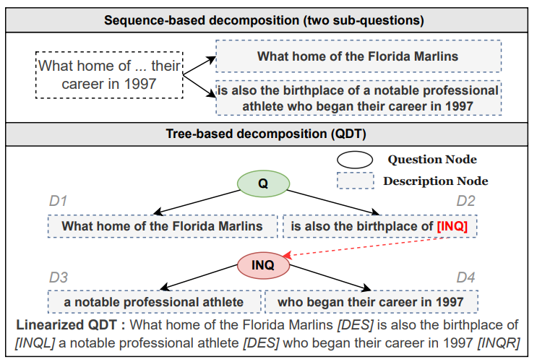
Question Decomposition Tree (QDT)
Complex Questions
Assumption: can be decomposed into some simple questions
Previous methods split a question into only two-parts
Insufficient to represent complex reasoning structure
Tree-based decomposition
Recursively defined
Better decomposition structure
Can be Linearized to a sequence
Introducing some tags for generation

Slide 9
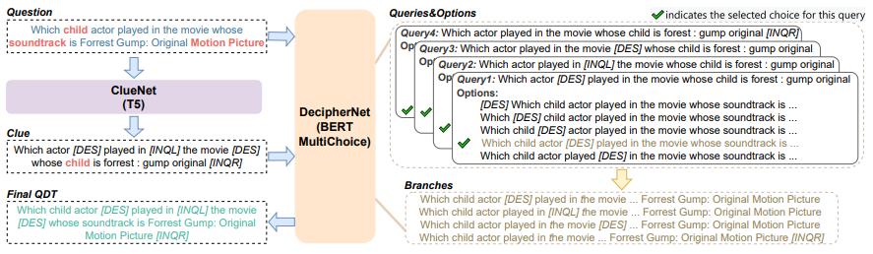
Decomposition Method (Clue-decipher)
Problems solved – output of generative LMs are uncontrollable
two-staged method
1. generate the decomposition (using the generation ability)
2. adopt a multi-choice model to determine inserting position for each tag (mitigating hallucination)

Slide 10
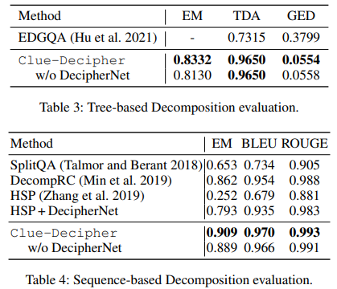
Experiments – Decomposition
Compare with tree-based and sequence-based methods
Different metrics
Annotate a dataset QDTrees from complex datasets and test on it
Clue-decipher significantly outperforms other methods

Slide 11
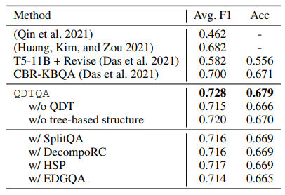
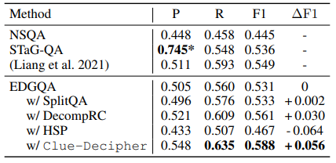
Experiments - KBQA
Adopt KBQA as downstream task to showcase the effectiveness of QDT
Significantly improve the result for two complex reasoning datasets in two KBs
Improve result of two different QA systems
Tree-structured decomposition substantially boosts the result

Slide 12
Limitations
We just do surface form decomposition (strong assumption)
Contemporary LLMs already do well in question understanding
Linking can be more difficult
With golden linking results, LMs can do quite well in complex datasets (95% F1 on ComplexWebQuestions)
Structures can be well learned from annotations
What can be further done for the community?

Slide 13
MarkQA: A large scale KBQA dataset with numerical reasoning

Slide 14
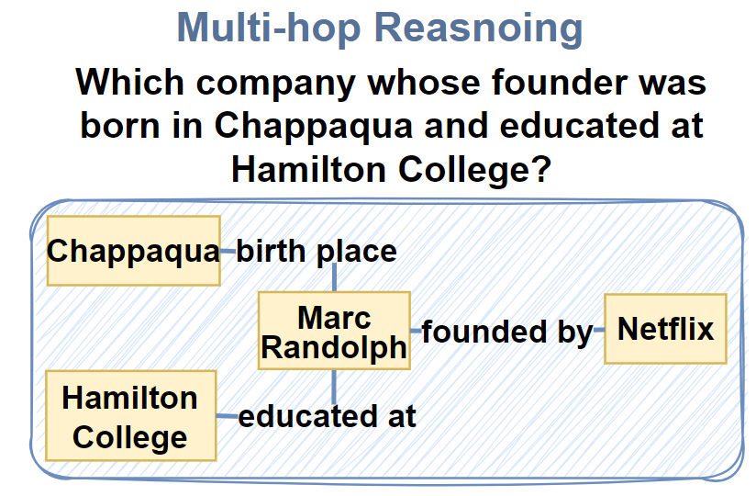
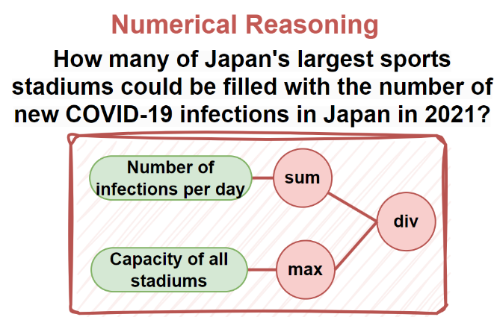
MarkQA: A large scale KBQA dataset with numerical reasoning
KBQA aims to answer a question over a knowledge base (KB).
Need to match a graph pattern in the KB
Numerical Reasoning is a critical ability in daily life
Require the ability of arithmetic, aggregation, comparison…

Slide 15
MarkQA: A large scale KBQA dataset with numerical reasoning
KBQA aims to answer a question over a knowledge base (KB).
Need to match a graph pattern in the KB
Numerical Reasoning is a critical ability in daily life
Require the ability of arithmetic, aggregation, comparison…
Acquire some Information
Further Process the Information

Slide 16
Motivation
Previous KBQA dataset mainly focus on Multi-hop reasoning(MR)
90% of question in CWQ
84.8% of question in GrailQA
Numerical reasoning is insufficient in current KBQA datasets
Account for a small proportion
Only focus on Count, Argmax, Compare
Require calculation at most once
For the first time explore and discuss Numerical Reasoning in KBQA from:
Task
Reasoning path representation
Dataset
Experiment

Slide 17
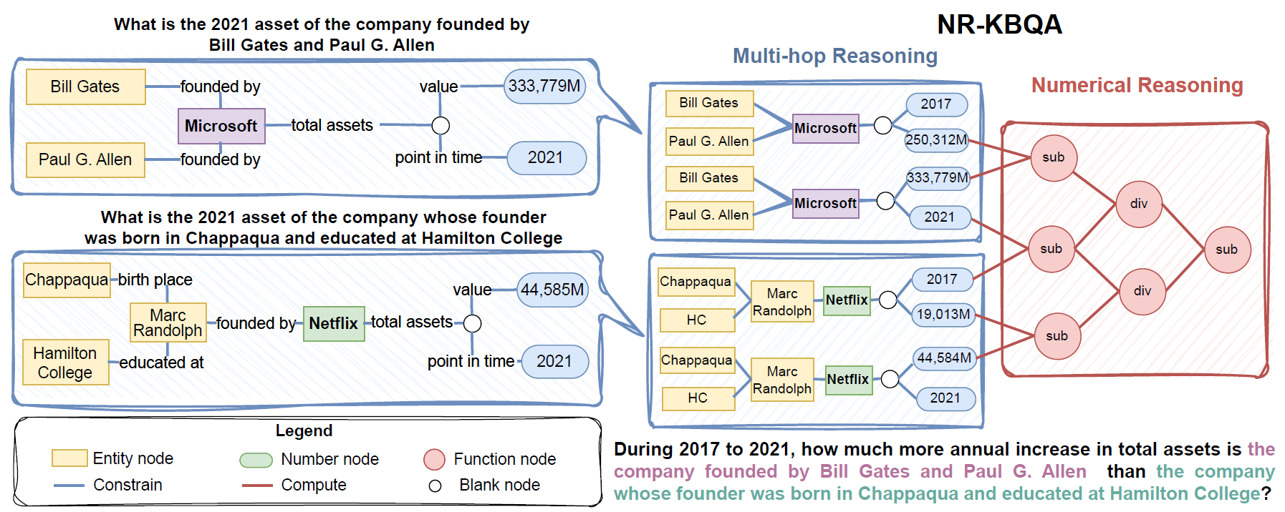
A New Task -- NR-KBQA

Slide 18
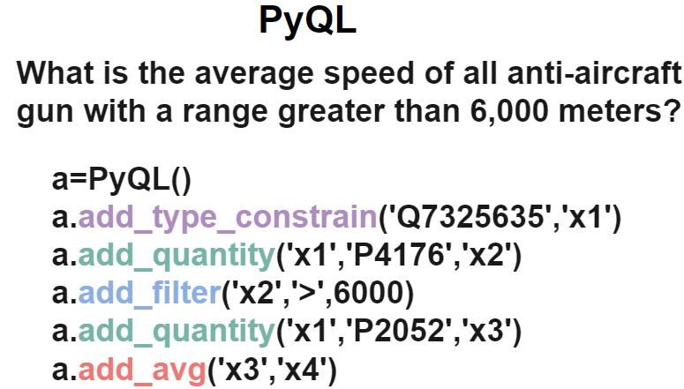
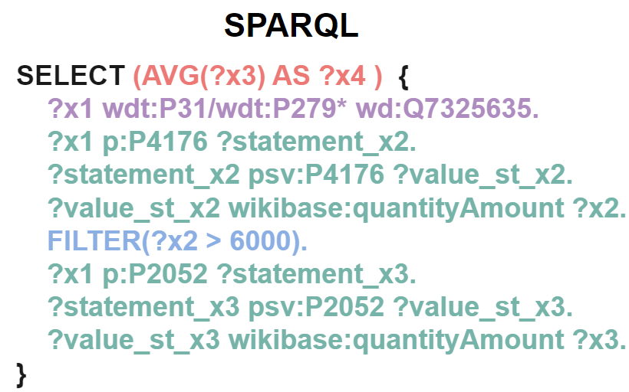
A New Representation -- PyQL
Represented as a set of Python code
PyQL(Pythonic Query Language for SPARQL)
Each line initialize a PyQL object or calls a function
Encapsulate various SPARQL syntax elements
BGP, Aggregation, Filter, Subquery, Assignment…
Can directly compiled to SPARQL
Advantages:
User-friendly and conciseness
Step-by-Step reasoning path

Slide 19
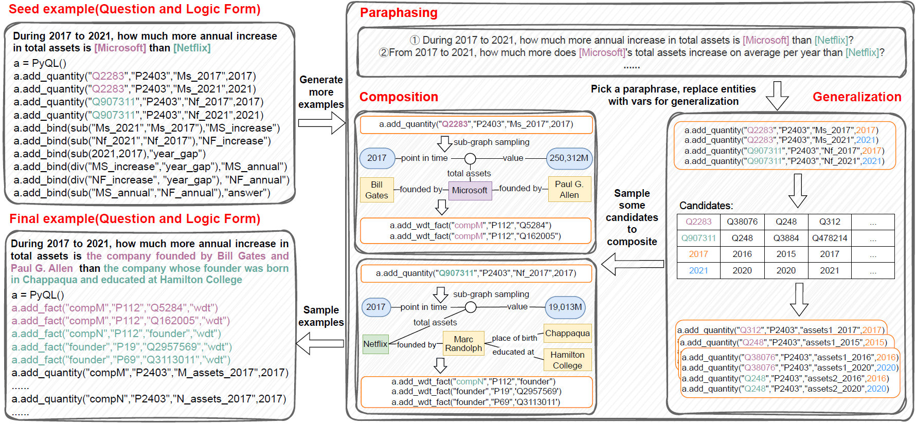
A New Dataset -- MarkQA
Dataset Construction
Starts from 1K questions posed by humans and automatically scales to 32K examples. The construction framework: Seeds-to-Forest(SoF) consist of four steps:
Seeds Collection
Paraphrase
Generalization
Composition

Slide 20
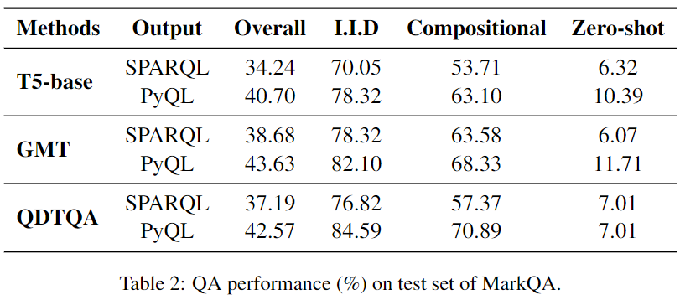
Experiment
Overall experiments

Slide 21
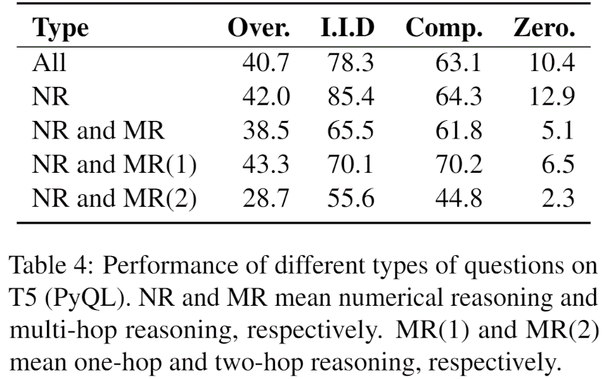
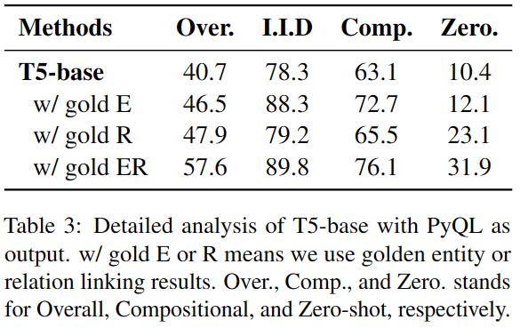
Experiment
Different reasoning type
Oracle experiment

Slide 22
Limitations
A lot human labor is involved in annotation
PyQL query can be generalized to other environments
How to well leverage PyQL query?
We prove the difficulty brought by structure, but how to handle it?
Do it with LLMs?

Slide 23
QueryAgent: A Reliable and Efficient Reasoning Framework with Environmental Feedback based Self-Correction
Running time, query engine times, LLM token cost
An agent framework for query building

Slide 24
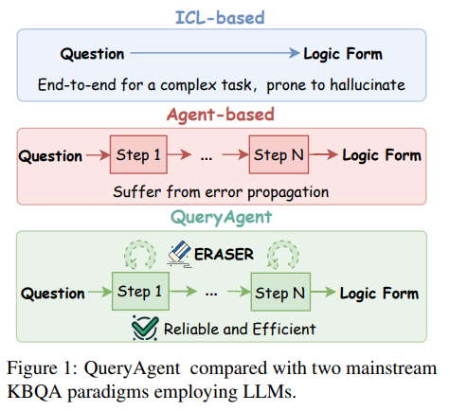
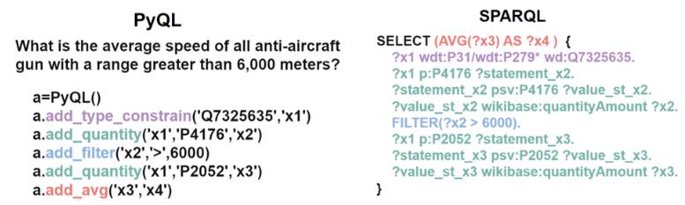
Motivations
PyQL query is step-wise-executable → step-by-step query building
An interface with knowledge base (retrieval tools and functional tools)
End2End ICL generation with LLMs induce massive enumeration and hallucination
Can adopt question decomposition for better understanding and use LLMs reasoning ability
Agent-based methods suffer from error propagation and hallucination
A novel correction method for reliable generation

Slide 25
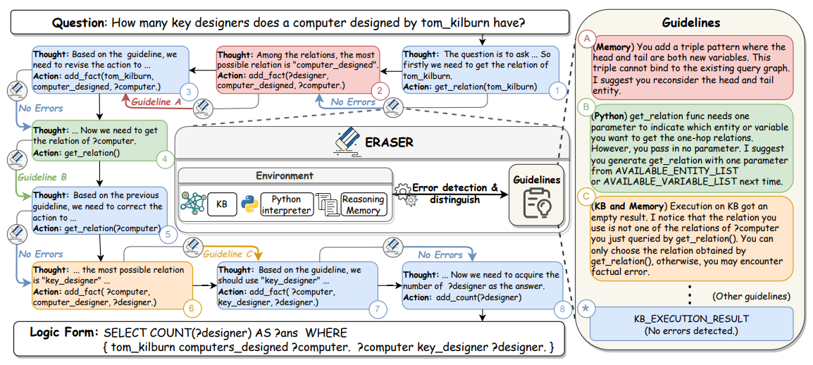
Agent framework (ReAct) with feedback-based self-correction
Agent framework – step-by-step query building with PyQL function tools
based on previous step, an LLM generates thought and action. The action is executed. A correction module, ERASER, detects and distinguishes possible error and collect guidelines and add it to observations.

Slide 26
ERASER
provide guidelines for possible hallucination
Previous: few-shot correction, relying on LLMs to identify the error and mimic the examples
Multiple feedback sources: KB engine, python interpreter and reasoning memory
Provide guidelines as observation (zero-shot, seamless correction)

Slide 27
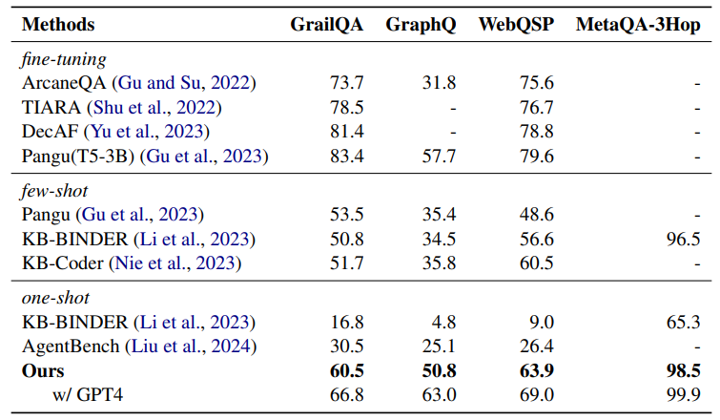
Experiments
Significant improvement with only one-shot example

Slide 28
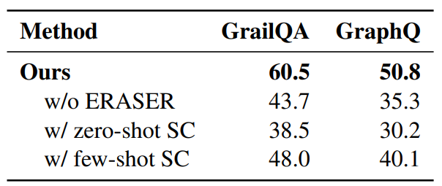
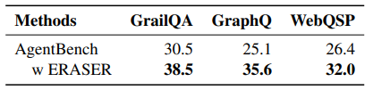
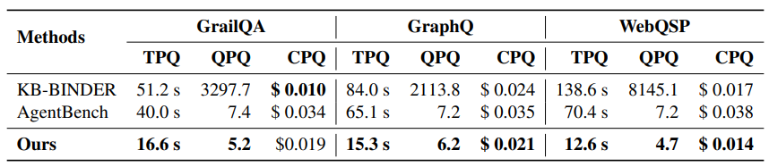
Analysis
Ablation study of ERASER
Transferability of ERASER
Efficiency in runtime, engine query time and token cost
Transferability
Ablation study
Efficiency analysis

Slide 29
Limitations
The correction guidelines are well crafted and based on diverse feedback
Based on the step-by-step manner, we have various feedback sources
The step-by-step reasoning is a fine-grained decomposition
Lead to lengthy prompts
LLMs understand a complex question well. Maybe we can achieve a different way of interaction
(human and animals tend to have a plan substantially and ground the plan in environments.)

Slide 30
Call me when necessary: LLMs can Efficiently and Faithfully Reason over Structured Environments
Idioms (when sharing business cards)
Call LLMs (how to practically invoke LLMs)
Less LLM calls
LLM’s output can be grounded on environments
Multi-hop reasoning over Structured Environments (KG, Tables)

Slide 31


Previous interaction paradigms
Interactive interaction
minimum effort at each step
E.g.: Who is Obama’s daughter?
Direct ：Obama -> daughter
Iterative
1. relations around Obama
2. choose daughter
pros
Decomposition for smaller environmental space
LLM discriminate at each step (better faithfulness)
cons
Incremental and minimum effort can by inefficient
Each step rely on previous steps, inducing error propagation
Multi-hop question may introduce multiple steps and some entity may involve massive relations, introducing long history
Injecting environments into models when training, End2End return when inference
Direct path generation or Retrieval-and-Build
Pros: no interaction at inference time, better efficiency
Cons:
Not ensuring faithfulness and relying on beam search, resulting in larger retrieved instances
Relying heavily on training data, hard to obtain for large-scale environments
(a) Iterative interaction with LLM apis
Multi-turn interaction
task
LLM
……
(b) fine-tuned PLM
End2end return
Supervised training
task
PLM
Structured environments

Slide 32

Reasoning Path Editing (Readi)
How humans interact？ How do we do multi-hop reasoning?
Which college did Obama’s daughter go to? Obama → daughter → college …
“Reasoning path” to represent structured reasoning process
Utilize strong understanding ability of LLMs
Can be instantiated on environments, bridging the heterogeneity gap
LLMs interacting framework to build a reasoning path
End-2-end generation of an initial reasoning path (less LLM calls)
Instantiation on environments，edit the path when anything goes wrong (better faithfulness)
Task
Error Message
LLM
Path Generation
Path Editing
Structured Environments
Path Instantiation
Reasoning Path
Standard operation
Only when necessary

Slide 33




Reasoning path
Structured representation of natural language task
Instantiable on structured environments (Knowledge graph)
Relational path from topic entities
Can represent complex constrains (conjunction)
Example $Q1$
Example $Q2$
Where did daughters of Obama go to college?
What country bordering France contains an airport that serves Nijmegen?
Reasoning Path
Reasoning Path
[Obama] father_of$→$college
[Nijmegen] serve_airport$→$contain
[France] border$→$country
Path Instances
Path Instances
Malia
airports
WZ air.
father_of
college
Nijmegen
contains
Obama
UCMC
German
adjoin
father_of
Sasha
college
France
Compound Node
country
Single-constrained Reasoning Path
Multi-constrained Reasoning Path

Slide 34
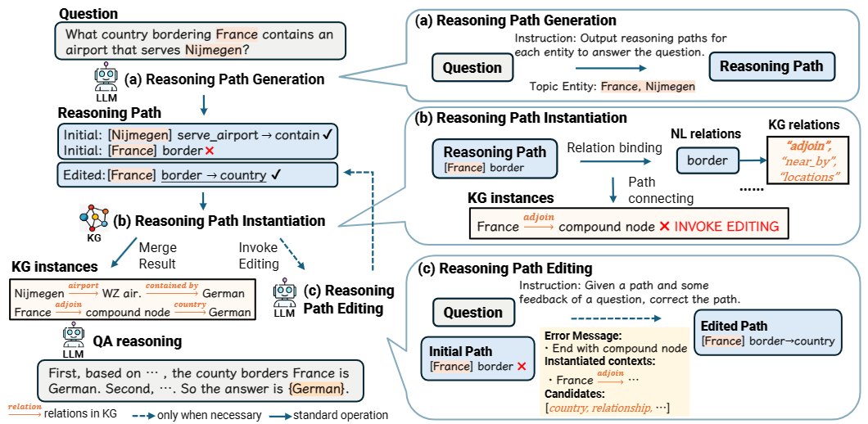
Method – Reasoning Path Editing (Readi)

Slide 35
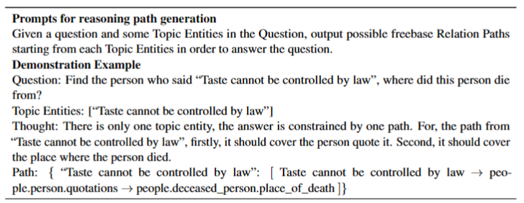
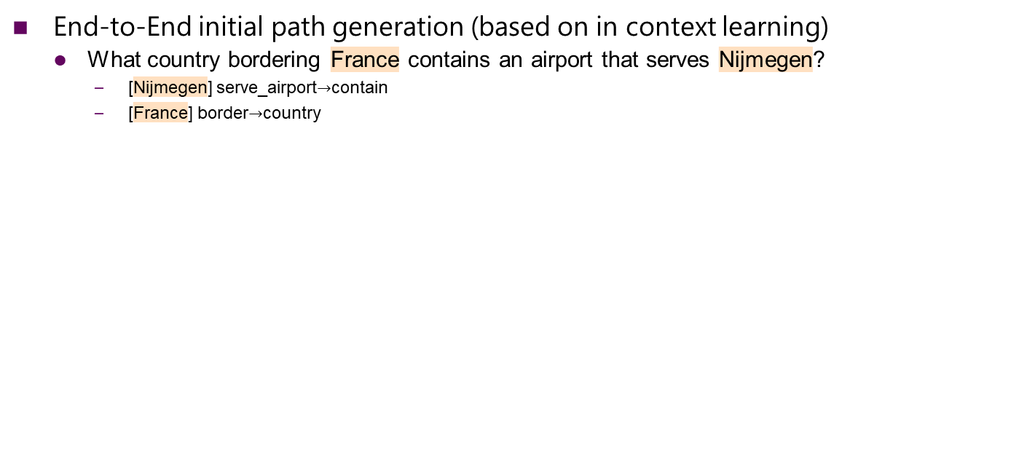
Method – Reasoning Path Editing (Readi)
End-to-End initial path generation (based on in context learning)
What country bordering France contains an airport that serves Nijmegen?
[Nijmegen] serve_airport$→$contain
[France] border$→$country

Slide 36
Method – Reasoning Path Editing (Readi)
Reasoning path instantiation：
First bind NL relations to knowledge base relations，then connect the relations (BFS)
Reasoning path: [France] border → country
Relation binding:
border ： {adjoin, near_by, locations}
country ： {country, locations, county}
Path connecting: France – adjoin – cvt node – country - …
...
Paris
capital
m.046cs69
country
adjoin
German
France
adjoin
...
currency
m.0z1zxph
Euro
country
Netherland
...
cvt node: compound value node in Knowledge graphs

Slide 37
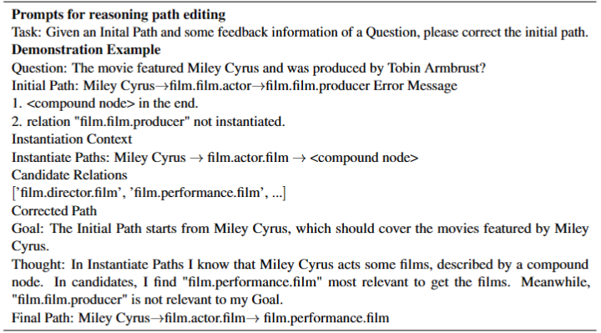
Method – Reasoning Path Editing (Readi)
Collect error messages for LLMs to edit previous path
Error reasons: cvt ending, empty reasoning path, current relation cannot be connected
Error messages: error reasons, instantiation progress, candidate relations

Slide 38
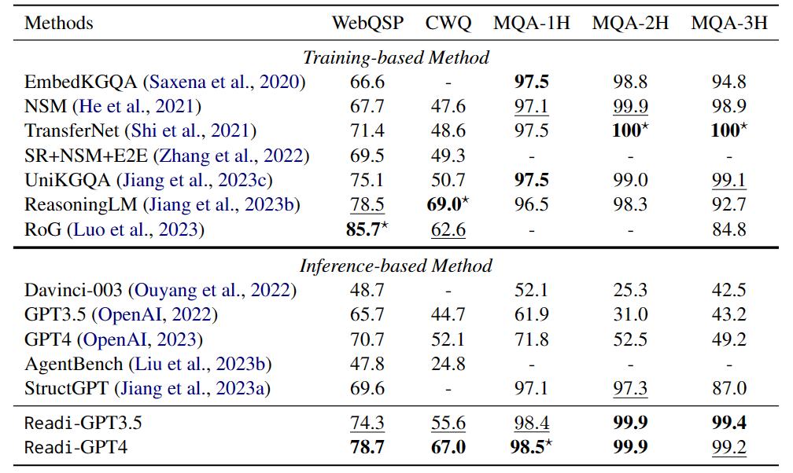
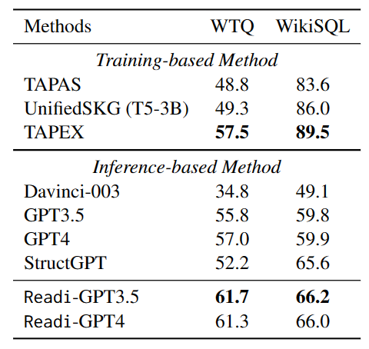
Experiments – Main Results
TableQA （denotation accuracy）
KBQA （Hit@1）

Slide 39
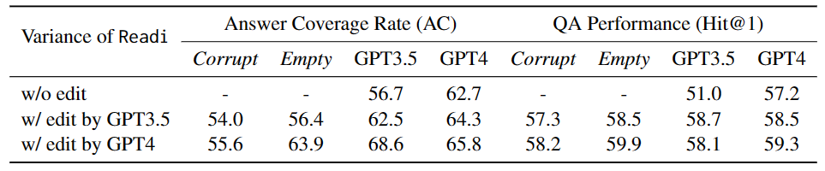
Analysis - Ablation Study (generation and editing modules)
Effectiveness of initial path generation (horizontal)
Effectiveness of path editing (vertical)
Editing for corrupt and empty path shows robustness
From left to right, from top to bottom, all show an upward trend
With stronger model, comes better results
Plug-and-play nature for initial path generation and editing
Notes:
2 hop 到 4 hop的分布

Slide 40
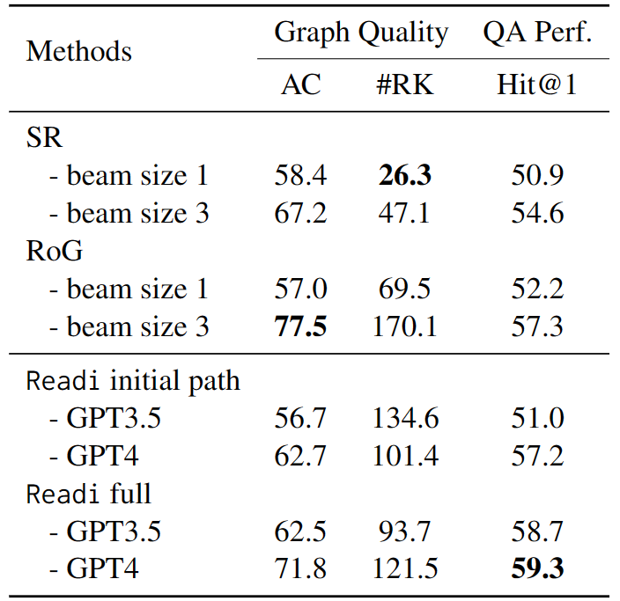
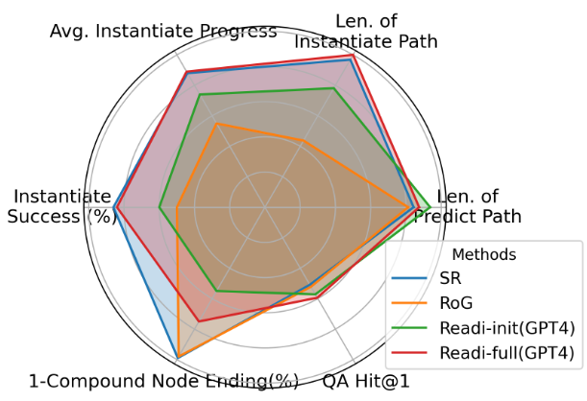
Analysis – Features of reasoning path
Readi’s initial path is competitive
GPT3.5 initial reasoning path is on par the finetuned methods
GPT4 initial reasoning path better than finetuned methods
After editing, Readi’s path outperforms finetuned methods with wider beams
Finetuned methods get exploded number of retrieved knowledge with wider beams
Still worse QA results than Readi

Slide 41
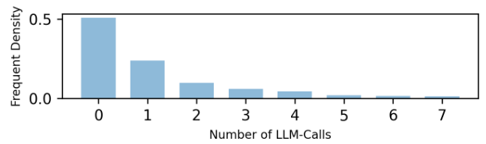
Analysis - Efficiency
Distribution of LLMs editing times
Averagely 1.55 – GPT4, 1.99 – GPT3.5
Half questions does not need editing (LLM called only once)

Slide 42
Limitations
Can try other LLMs to test generalizability of our framework
The Instantiation is natural but a bit brute force
The interaction is relatively efficient and faithful, does not ensure the instances we obtain can be used to answer the question
We adopt LLMs ability to generate reasoning path, the path can be fully instantiated does not mean the path is the ground truth
This is also the limitation of IR

Slide 43
Thanks for listening
Q&A

